Slide 1
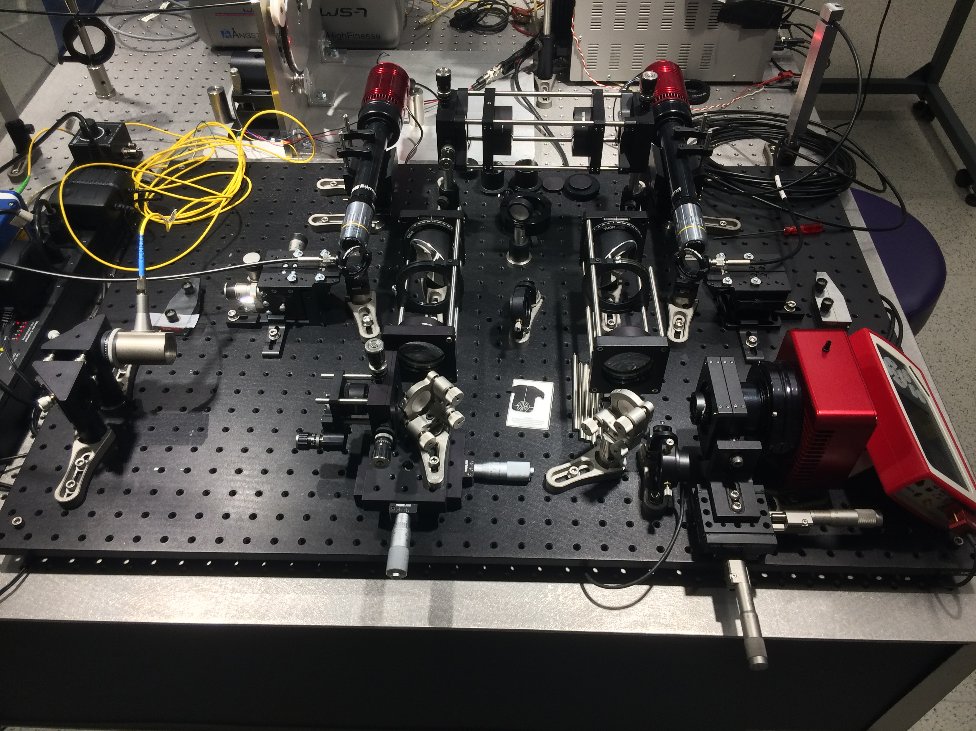
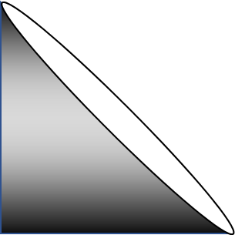
Agitation
Selection
Input
Near Field
10x
10x
Light Source Selection
Far Field

Slide 3
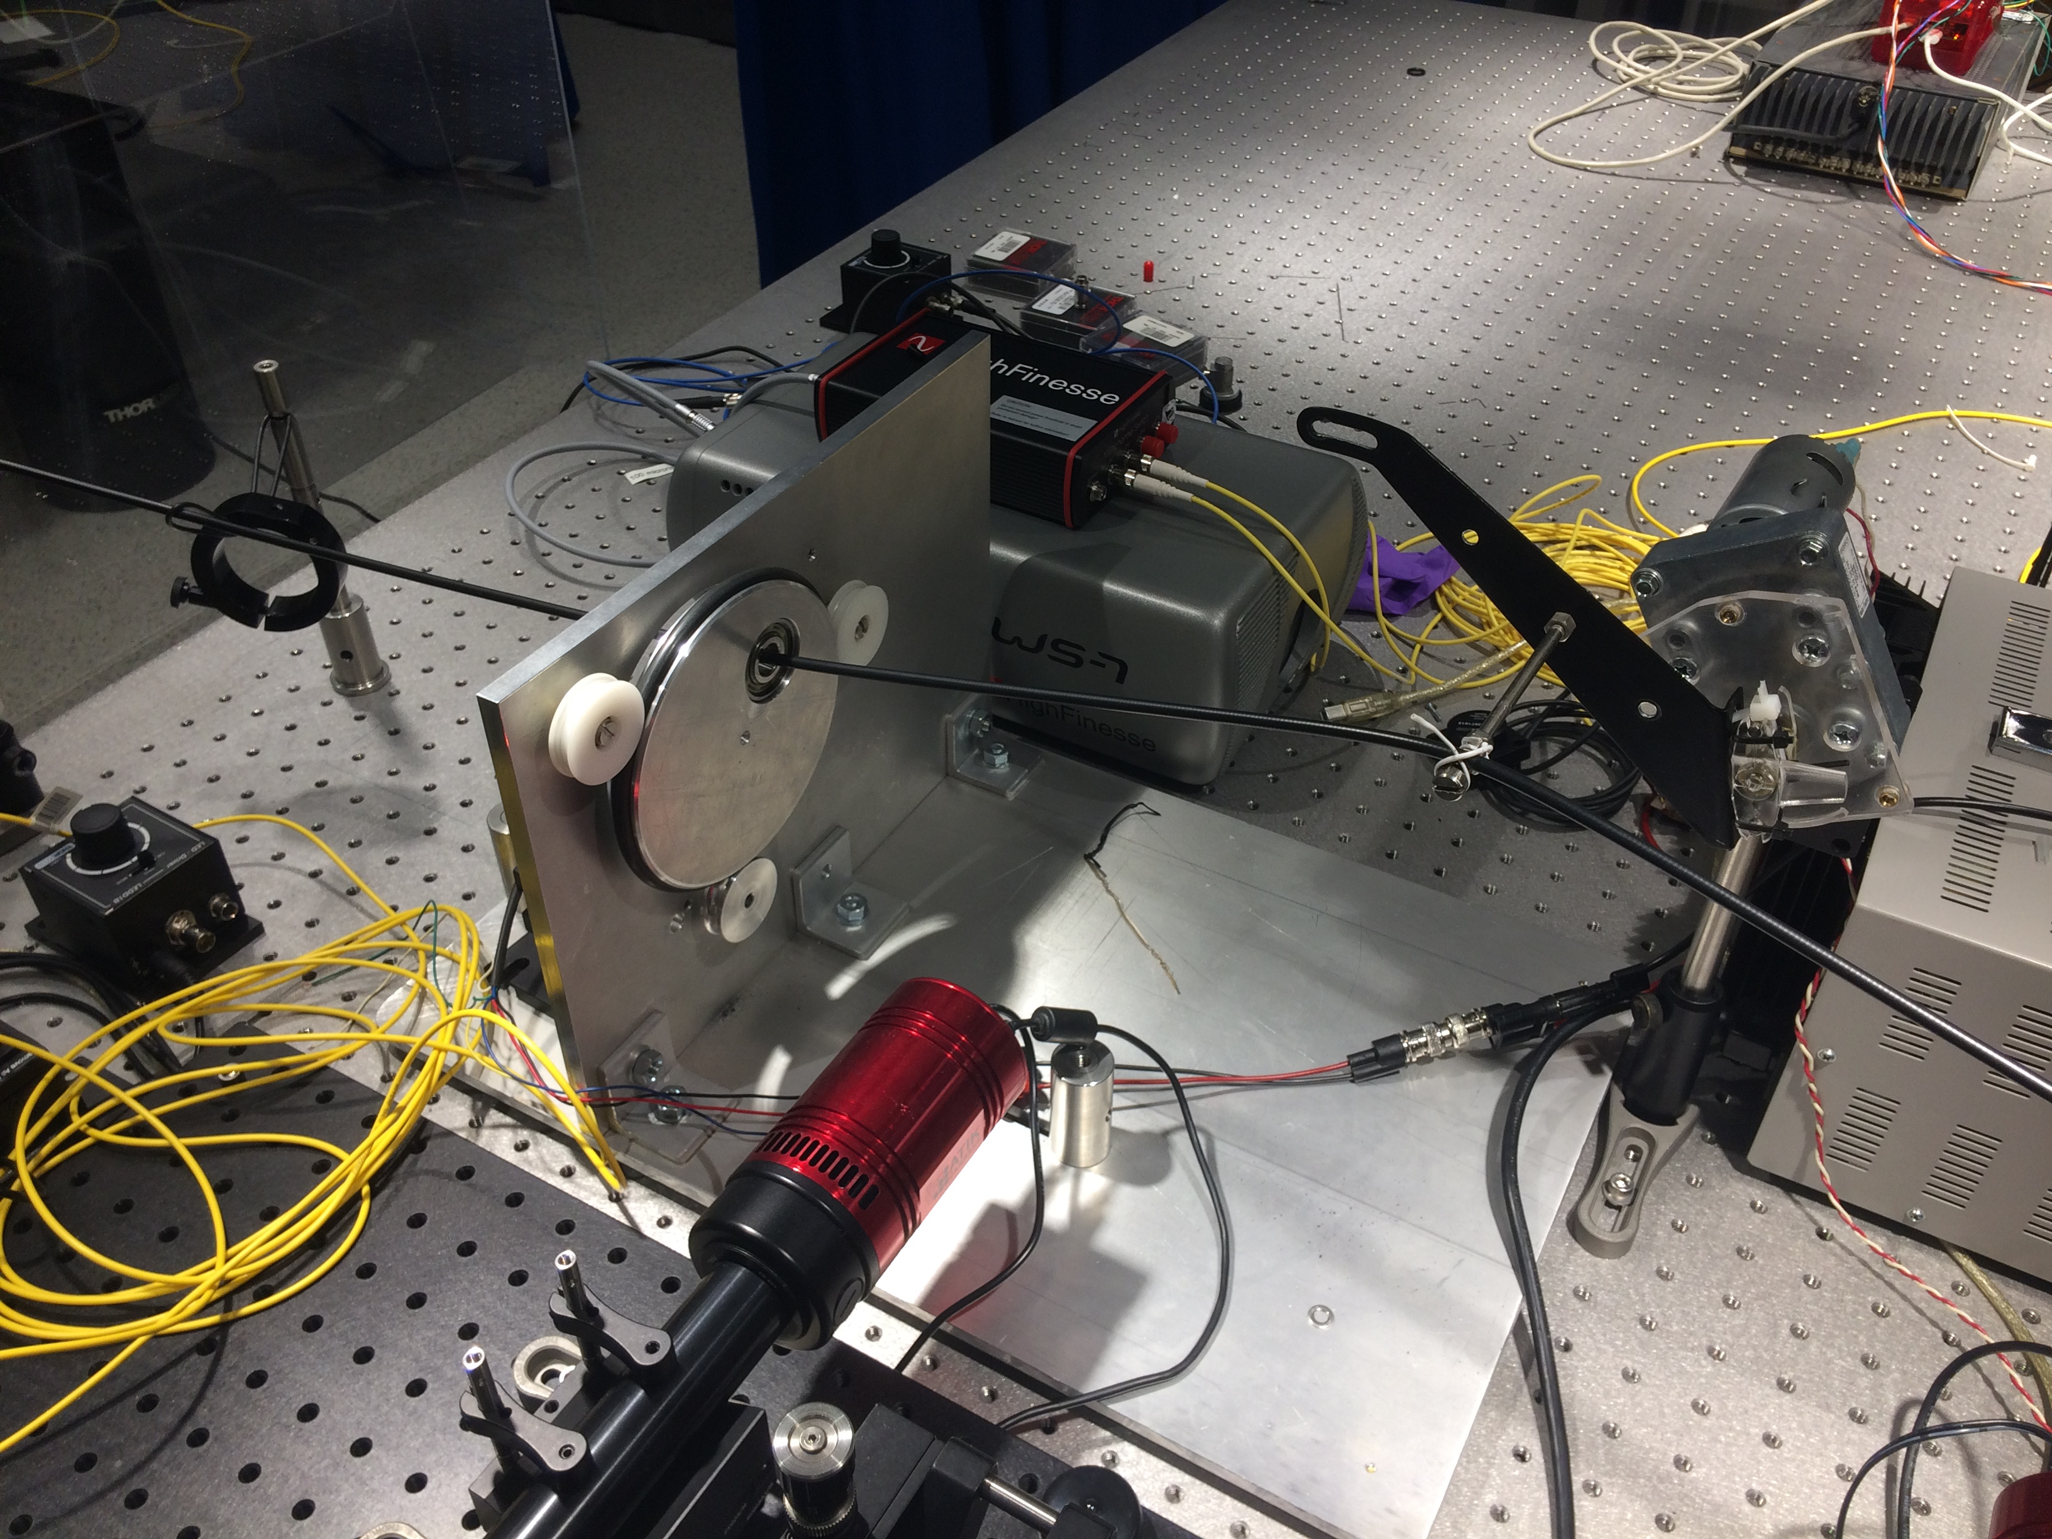
Counterweight
Circular Agitator
Linear Agitator
Rotating Arm

Slide 4
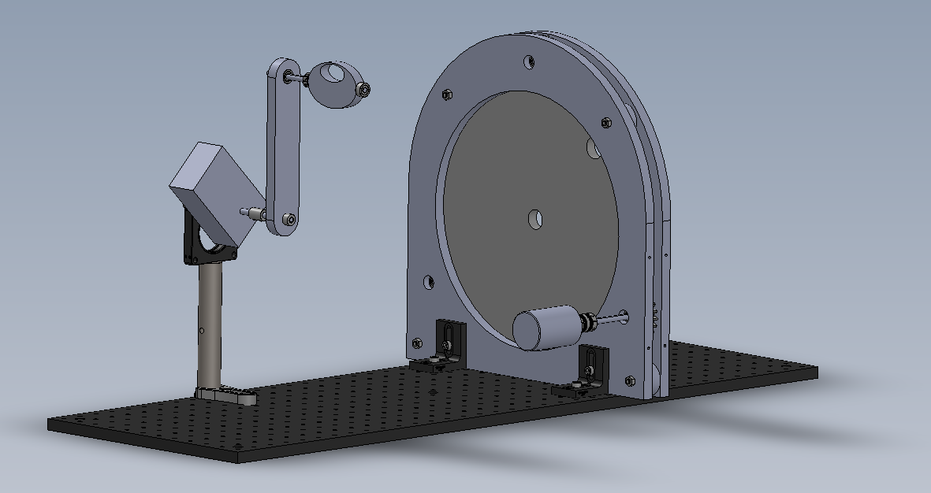
320 mm
Linear Agitator
320 mm
Circular Agitator

